Slide 1
What does this program do?
public class Twisted {
private final String name;
Twisted(String name) {
this.name = name;
}
private String name() {
return name;
}
private void reproduce() {
new Twisted("reproduce") {
void printName() {
System.out.println(name());
}
}.printName();
}
public static void main(String[] args) {
new Twisted("main").reproduce();
}
}
Notes:
You would think it would print reproduce. It instead prints main.
name() is private, so is not available to the anonymous inner class.
It instead binds to the nearest available name(), which is the parent class’s name().

Slide 2

CSSE 374 Software Design Agile and Greenfield

Slide 3
Outline
Questions on agile
Discussion questions on agile
Questions on the case studies
9-2 Design Studio

Slide 4
What is agile??
Can Agile be explained a little bit more? I do not really know much about it.
Notes:
Agile is a philosophy that encompasses several common software processes.

Slide 5
12 principles (1/2)
Our highest priority is to satisfy the customer through early and continuous delivery of valuable software.
Welcome changing requirements, even late in development. Agile processes harness change for the customer's competitive advantage.
Deliver working software frequently, from a couple of weeks to a couple of months, with a preference to the shorter timescale.
Business people and developers must work together daily throughout the project.
Build projects around motivated individuals. Give them the environment and support they need, and trust them to get the job done.
The most efficient and effective method of conveying information to and within a development team is face-to-face conversation.
https://agilemanifesto.org/principles.html

Slide 6
12 principles (1/2)
Working software is the primary measure of progress.
Agile processes promote sustainable development. The sponsors, developers, and users should be able to maintain a constant pace indefinitely.
Continuous attention to technical excellence and good design enhances agility.
Simplicity--the art of maximizing the amount of work not done--is essential.
The best architectures, requirements, and designs emerge from self-organizing teams.
At regular intervals, the team reflects on how to become more effective, then tunes and adjusts its behavior accordingly.
https://agilemanifesto.org/principles.html

Slide 7
Who does what?
This whole section is really confusing to me as I struggle to find out which level of the project team is doing what?
It feels like there are times where the article discusses high-level architecture decisions and then turns around and say that it should be implemented before being added to the architectural vision.
It just confuses me because I wouldn't think a software architect would be concerned with actual implementation, but rather more high level decisions.

Slide 8
Source of the confusion?
Principle: Prove it with working software
Scott Ambler put it this way: "[P]rove it with code." Any architecture that the team thinks it needs or any decisions that the team needs to make about the product's architecture should be proven with code.
Notes:
“Is this really what’s needed?”

Slide 9
What that means
The architect determines the simplest solution using technical spikes.
Team members help code the different alternatives.
The team otherwise self-organizes: it decides for itself how to “divide up” the vision for implementation.

Slide 10
“Simplest thing that works”
I'm a little confused on "The simplest thing that could possibly work" when in some cases, "the simplest" is to not worry too much about design at all.
Notes:
“Work” being the operative word. What does working mean?
If code compiles, does it work?
If code runs, does that count as working?
What if wrote one test case and your code passes that test case? Does that count?
“Working” is much more than even these notions of “functioning.”
We have to get to that functioning state within real-world time and resource constraints.

Slide 11
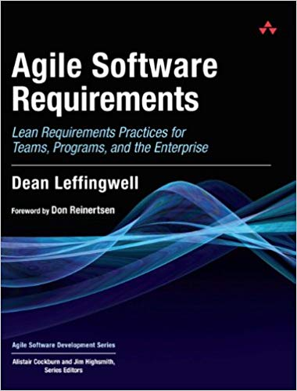
Scaled Agile Framework (SAFe)
I'd really like to learn more of the ideas behind Scaled Agile Framework. It seems like it would be particularly useful in the modern businessplace.

Slide 12
Does anyone do both?
Do companies actually use both Agile and architecture?
Notes:
Yes… and the ones following Agile tend to use Leffingwell’s SAFe.

Slide 13
Discussion questions

Slide 14
Discussion question 1 on agile
Is it a good idea to always try to use Agile principles and strategies when making software?

Slide 15
Discussion question 2 on agile
So I'm not totally sure what a completely non-Agile project would look like. Isn't constant reevaluation a necessary part of writing code, and therefore isn't Agile pretty much necessary?
How would you go about writing code with zero adaptation when you realized your design was wrong?

Slide 16
Discussion question 3 on agile
The "last responsible moment" principle seems to contradict the "fail fast, learn rapidly" ideas. Should we try and take risks sooner to get them out of the way, or wait until we can make a more educated decision?

Slide 17
Questions on the case studies
FCAPs and “Big Data”

Slide 18
Seeing the connection
I would like the iterative process to be explained in less detail such that I may get a more general understanding of the similarities in the two iterative processes exemplified in the two chapters.
I just got lost trying to keep track of all the details presented in each process and the overall concept that was being conveyed.
Notes:
Remember: the overall concept was already conveyed in a different chapter.

Slide 19
What you read in Chapter 3
Review Inputs
Establish the Iteration Goal by Selecting Drivers
Choose one or more elements of the system to refine
Choose one or more design concepts that satisfy the selected drivers
Instantiate architectural elements, allocate responsibilities, and define interfaces
Sketch views and record design
Perform analysis of the current design and review iteration goal and achievement of design purpose
Is there anything you find particularly confusing about any of these steps?

Slide 20
How I read Chapter 3
I read the Table of Contents for Chapter 3.
In my notes: I wrote down the names of each section.
As I read the sections, fill in major ideas in each section.
After each section: I rename the section in my own words.

Slide 21
My Ch 3 notes
Ch 3: Architectural design process
1. Review inputs
2. Select drivers (requirements) to implement
3. Choose elements to refine (ie a top-down decomposition of "the system")
4. Choose design concept (patterns, tactics, reference architectures, deployment patterns, frameworks ...) to apply
5. "Instantiate" concept, ie decide how many layers, interfaces between things, etc.
6. Draw and record what this will actually look like
7. Review w stakeholders
- Repeat 2-7 until most risky requirements are met
What do your notes look like?
(Did you take any?)

Slide 22
Why we read these cases
What's the point of looking at these two cases?
Is there one overall major difference?
Notes:
Examples of the design process: what specifically did they do in real life companies?
The key difference is: the first system is an example of the process applied to solve an old problem where the solution was obvious.
The second system solves a relatively new problem for which the solution was not obvious.

Slide 23
Where is the design?
I find these chapters hard to read because the words are split up with the tables and such.
Which part of the chapters is actually describing the design?
Notes:
Remember: ADD is a process in which you record your decisions and rationale. The chapters illustrate the complete design rationale at every stage of the product’s creation.
In other words: the chapters are telling a story about the creation of some software and why it was created that way.
Both stories follow the ADD process. So you need to follow the steps in Chapter 3 of the book closely to understand what is going on.
Furthermore: the design of a system is not simply one class diagram. There are lots of moving parts and there are different views of each part that come together to describe the whole system.
But let’s take a stab at identifying the design of each system. Maybe you would like to see some UML?

Slide 24
Figure 4.5 – FCAPS domain model

Slide 25
Figure 4.7 – Client Architecture

Slide 26
Figure 4.7 – Server Architecture

Slide 27
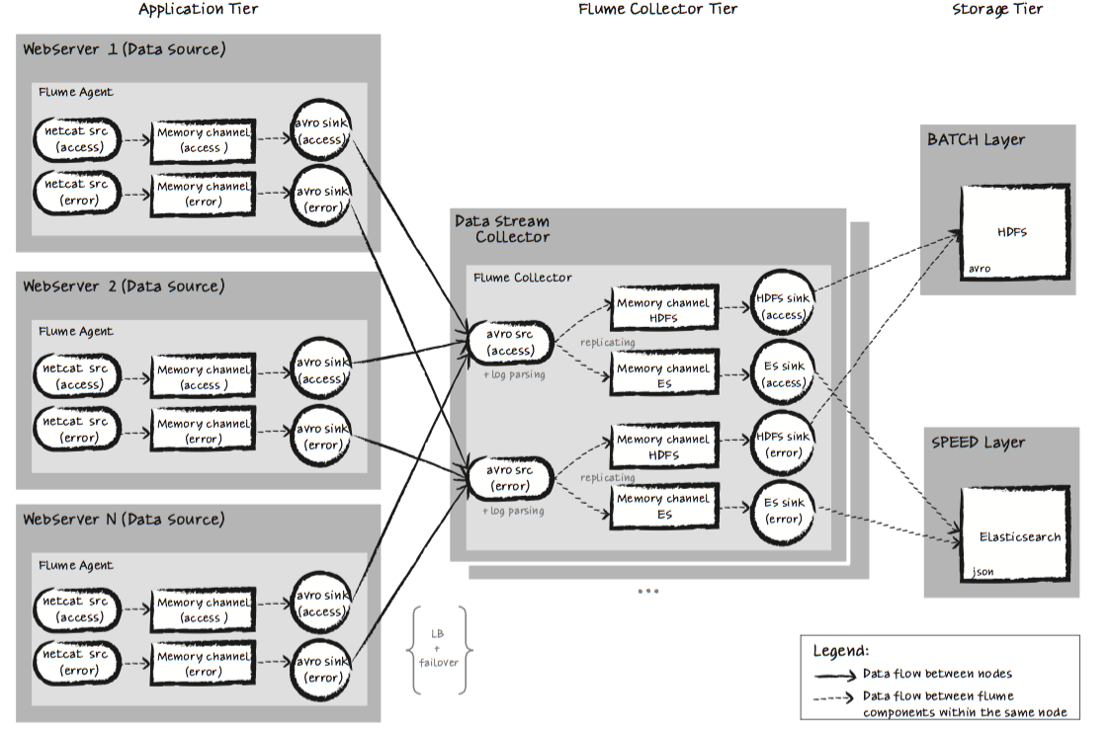
Figure 5.8 – “Big Data” final architecture

Slide 28
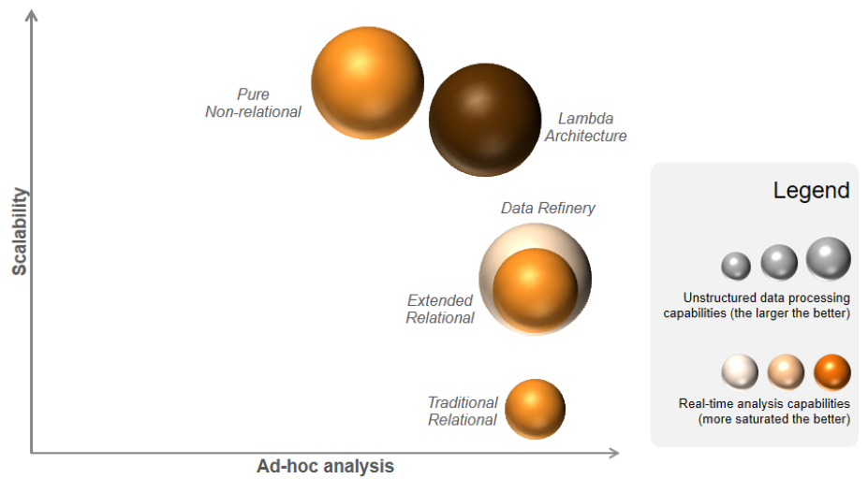
How do you read Figure 5.3?
Notes:
Cervantes and Kazman have this wild idea that we should not make decisions based on our gut, but rather think about the tradeoffs between factors.
This diagram visualizes a four-dimensional analysis of tradeoffs. You could just as easily illustrate it other ways, ie with Table 5.1.
As you can see, the lambda architecture is on the efficient frontier.

Slide 29
Real world example?
Is there a real world example of FCAPS? or was that just an example in the book?
Think about your favorite topic in computer science.
Imagine 10 years from now that you are a world-renown guru in your favorite area. You help lots of companies solve all their problems in this topic.
You say, “Gee, everyone keeps making the same mistakes. I would love to share the work from my recent Amazon gig with the world so they can learn from Amazon’s mistakes.”
How do you think Amazon would feel about you sharing their mistakes?
Notes:
The FCAPs model is a real world example.
They didn’t put real names because they wanted to protect the identities of the guilty.

Slide 30
What do you focus on?
It seems like there are several different focuses a software architecture can take when designing and building it. How do you go about choosing the best path for solving a given design problem?
Notes:
Again: use a prioritization system. RICE from 371 is one way. Cervantes and Kazman rank things by the product of importance to client and technical risk.

Slide 31
Other drivers?
When dealing with business cases and quality attributes like these, should a design be based solely off the given cases and attributes or should a software engineer design for other attributes and possible cases as well?
Notes:
Remember there is more on the list of architectural drivers than just use cases and quality attributes.
Architectural concerns is a broad umbrella of technical risks that are not immediately apparent from the use cases/quality attributes.
For example, if you have a web server talking to a browser, they need a common schema. But if the web server is written in Java and the client is written in JavaScript, then there is no obvious way to make them share a common schema.

Slide 32
Advanced Databases?
Are there an classes that go into further depth regarding data analytics and tools for the different steps regarding this field?
Notes:
Sriram is teaching how you set all this up in the Spring.

Slide 33
Relying on external technologies
I liked the different approaches that were taken, but I was wondering how using open source technologies, which the second case study emphasized using, affects architecture decisions, because those dependencies on external libraries can be broken with every new update of those softwares.
It seems like adding these external dependencies go against our preexisting design notions where we focus on making sure that our design is "future-proof"
Notes:
Thus: you usually specify the version of the software you want to use and stick with it.

Slide 34
Design studio

